Slide 1
NACS 2019 OFFICE 365 AI WORKSHOP
Albert-Jan Schot
Rick van Rousselt
Stephan Bisser
Thomas Gölles

Slide 2
Agenda
Timeslot | Topic | Name | Comments
9 | Introduction | Stephan | Come up with assignment format
9.5 | Basic Bot | Stephan
10 | Plan Phase | Stephan
10.5 | Plan Phase - design dialog flow | Stephan | Create a assignment for users
11 | Build Phase | Thomas & Appie
11.5 | Build Phase | Thomas & Appie
12 | Lunch
12.5 | Lunch
13 | Lunch
13.5 | Build Hello world | Thomas & Appie | Split group in starters (Q&A Maker sample & Advanced Real Code)
14 | Build Hello world | Thomas & Appie
14.5 | Test Phase | Rick
15 | Test Phase | Rick
15.5 | Package / Publish | Rick
16 | Connect | Appie | slides
16.5 | Evaluate
Intro Introduction (10 min)
Basics of Bot Framework and Cognitive Services (50 min) - Overview of the cognitive services that make sense for bots - bot framework: basics authentication + basic graph - V3 vs V4: going to use V4
Plan phase: - dialog flow - Bot tools V4 (CLI, Dispatcher) - Chatdown (happy - non happy path) - adaptive cards (azurewebsite + how it works) - Our Scenario: How are we going to do it.
Build phase: - 1st hello world bot : different types of dialog flows (not to long!) - setup our scenario: Create QnA, Create Luis, Create webhooks - Let attendees play around with it. (create/find lab to follow) - Create(take the one from Stephan) an example question/answers page so that everybody has te same data. - app insights (implement)
Test phase (after lunch => maybe split the group into noobs and experts) - Emulator + running locally + ngrok - Automatic testing - Logging all the questions => dashboard (virtual assistant PowerBI Dashboard)
Publish phase - Azure Devops auto build and release - Deploy from VS
Connect phase: - Channels (overview + connect to Teams and webchat)
Evaluate phase: - Process feedback from the log files - use feedback to update models - app insights

Slide 3

Who are we?
ALBERT-JAN SCHOT, MVP (NL)
RICK VAN ROUSSELT, MVP (BE)
THOMAS GÖLLES, MVP (AT)
STEPHAN BISSER, MVP (AT)
@appieschot
@RickVanRousselt
@thomyg
@cloudguy_pro

Slide 4
Agenda
Intro
Basics of Bot Framework and Cognitive Services
Plan phase
Build phase
Test phase
Publish phase
Connect phase
Evaluate phase

Slide 5
Basics of Bot Framework and Cognitive Services

Slide 6
What is ARTIFICIAL INTELLIGENCE?

Slide 7

Artificial Intelligence
“Intelligence exhibited by machines […] mimicking functions associated with human minds” - Wikipedia
Reasoning
Understanding
Interacting
Learn and form conclusions with imperfect data
Interpret meaning of data including text, voice, images
Interact with people in natural ways

Slide 8

Why now?
Sphinx voice recognition
1992
Powerful algorithms
Grant calculator
1877
Shakey reasoning robot
1969
Compute power
VaMP self-driving car
1994
Big Data
AT&T Voder
1939
GUI
1981
Mechanical
Electronics
Computers
Cloud + AI

Slide 9
1990s: Internet
Search
User “visits” websites
The future: Conversations
Natural language between people and technology
Conversational canvas
Bots and agents
Conversational AI
The evolution of computers and IT
1980s: PC
Desktop
2000s: Mobile
Social
User download apps from App Stores

Slide 10
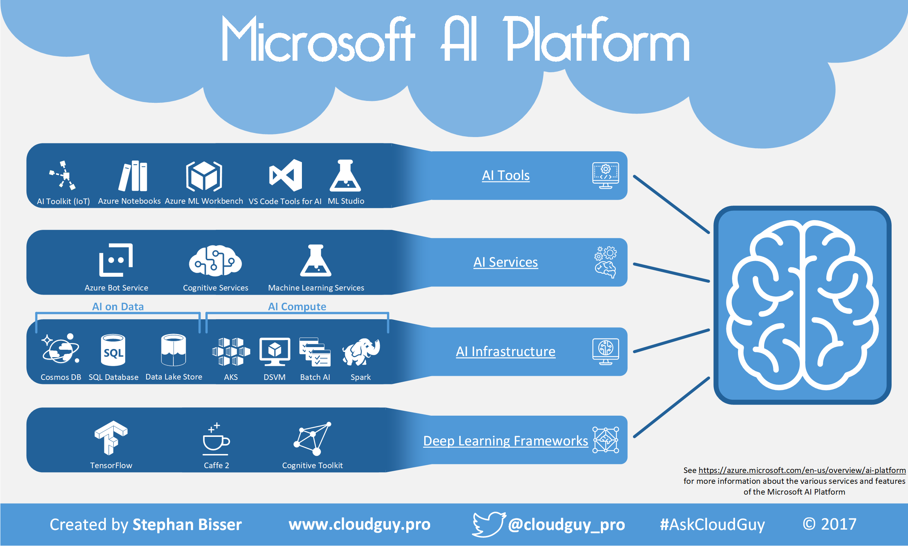

Slide 11
Conversational AI
Conversational AI is a subfield of artificial intelligence focused on producing natural and seamless conversations between humans and computers
A new user interface paradigm
Exposes software services through conversational interface
In apps, browser and on IoT devices
Pro-active capabilities (Virtual Assistant etc.)
Bots

Slide 12
Bots 101
“a computer program designed to have a conversation with a human being, especially over the internet” *
* https://dictionary.cambridge.org/dictionary/english/chatbot

Slide 13
Bots 101
It’s one thing: it’s an app that performs an automated task
It solves the user’s needs in the quickest/easiest way compared to any other option... like an app, or a website

Slide 14
INTEGRATING AI INTO BUSINESSES
IT staff should acquire fundamental knowledge of statistics and AI algorithm development
This enables IT to help colleagues in other departments better understand the possibilities of artificial intelligence and with them, improve the relevant models
This knowledge leads to a higher level of qualification and enhances individual creative thinking

Slide 15


The Business Case for Bots
…
Automate routine work
Faster transactions
Introduce AI in a friendly way

Slide 16
The Use Cases for Bots
…
QnA Bot
Bots + Microsoft Graph
People Search
Access to Exchange Online, SharePoint Online, Teams, …
Dynamics 365 Bot
Digital assistent for agent during phone calls/support tasks
Support Bot
Search Bot

Slide 17



Modernizing the company FAQ
Use cases spanning departments, job functions
Company FAQ, powered by Azure Bot Service,
QnA Maker, and Teams
Departmental knowledge
FAQs for team-specific knowledge like acronyms, locations, pointers to documentation, and onboarding
Company info
+
+
+
Company wide like FAQs like corporate info, holidays/dates, and events
Troubleshooting/support
Create a support knowledge base that end users or agents can easily access

Slide 18




Today’s Org Chart
Board
Chief Executive Officer
Finance
Sales & Marketing
HR
Operations
By Erik Ralston & Pieter van Aarde https://myignite.techcommunity.microsoft.com/sessions/67412?source=TechCommunity

Slide 19

Tomorrow’s Org Chart
Board
Chief Executive Officer
Finance
Sales & Marketing
HR
Operations
By Erik Ralston & Pieter van Aarde https://myignite.techcommunity.microsoft.com/sessions/67412?source=TechCommunity

Slide 20

How Do We Get There?
Board
Chief Executive Officer
Finance
Sales & Marketing
HR
Operations
Partners
(Extranet)
Personal Assistants
Team Assistants
Enterprise Assist
External Assist
By Erik Ralston & Pieter van Aarde https://myignite.techcommunity.microsoft.com/sessions/67412?source=TechCommunity

Slide 21
Bots – Democratic & Personalized
Personal Assistant -
Books meetings, organizes calendar
Chief Executive Officer
Finance
Sales & Marketing
HR
IT
Personal Assistant
Personal Assistant
Personal Assistant
Personal Assistant
Payroll Assistant
Time Sheet & Leave Assistant
Infrastructure Assistant
CRM Assistant
Expenses Assistant
Skills Finder Assistant
Password Reset Assistant
Brand Guide Assistant
Corporate Information Assistant
Helpdesk Assistant
Budget Assistant
By Erik Ralston & Pieter van Aarde https://myignite.techcommunity.microsoft.com/sessions/67412?source=TechCommunity

Slide 22




Bots 101
Platform
Platform services
HTTP
AI
{ Your Code }
Intelligent tools
REST Endpoint
SDK
Bot builder SDK
REST endpoint
Direct Line Protocol
Conversational and business logic
Canvas aware
Context sensitive

Slide 23
How do Bots work?

Slide 24
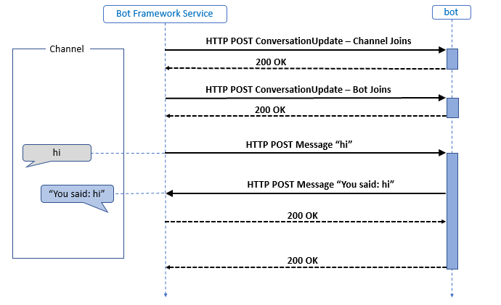
How Bots work

Slide 25
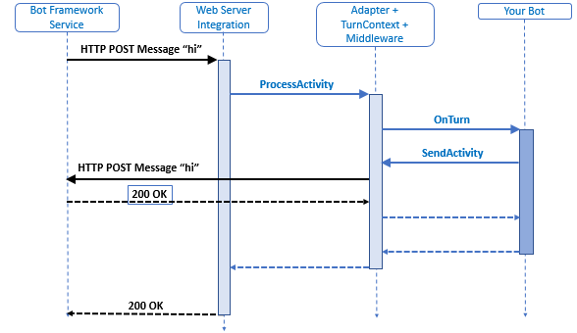
Activity Processing Stack

Slide 26
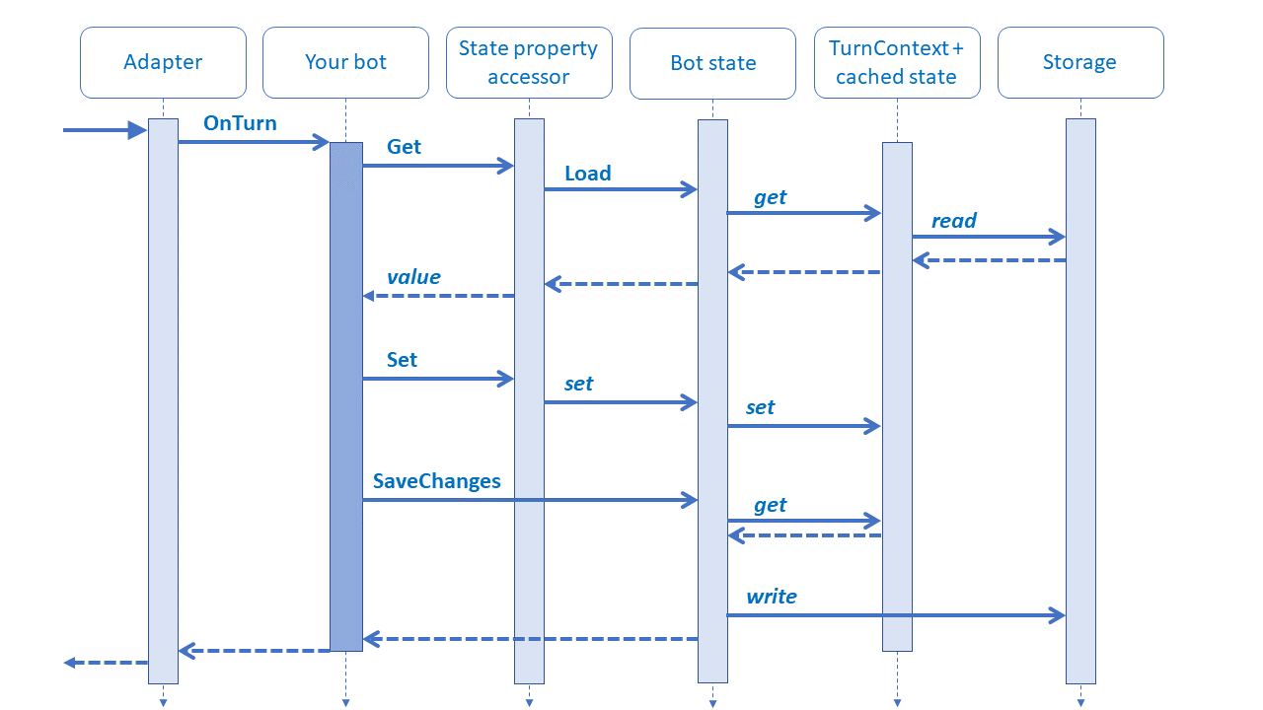
State Management

Slide 27
Middleware
1st middleware
2nd middleware
Bot logic
next()
1st middleware object’s turn handler executes code before calling next.
2nd middleware object’s turn handler executes code before calling next.
The bot’s turn handler executes and returns.
2nd middleware object’s turn handler executes any remaining code before returning.
1st middleware object’s turn handler executes any remaining code before returning.
next()

Slide 28
.bot file
With a .bot file, you can register services like:
Localhost local debugger endpoints
Azure Bot Service registrations.
LUIS.AI gives your bot the ability to communicate with people using natural language..
QnA Maker Build, train and publish a simple question and answer bot based on FAQ URLs, structured documents or editorial content in minutes.
Dispatch models for dispatching across multiple services.
Azure Application Insights for insights and bot analytics.
Azure Blob Storage for bot state persistence.
Azure Cosmos DB - globally distributed, multi-model database service to persist bot state.

Slide 29
Microsoft Bot Framework

Slide 30
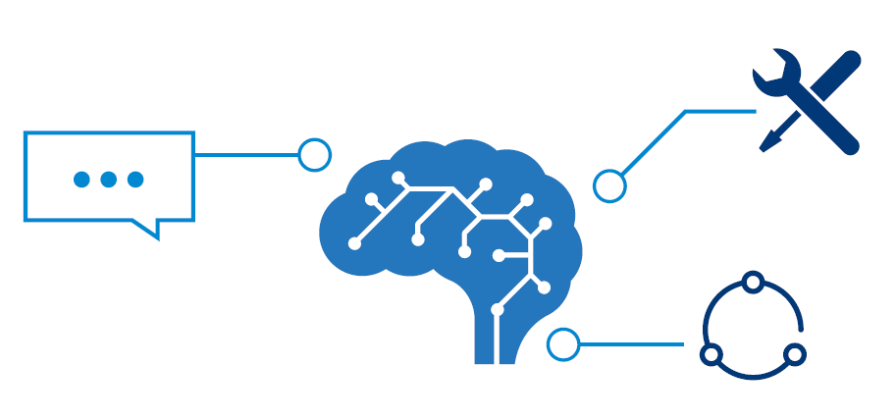
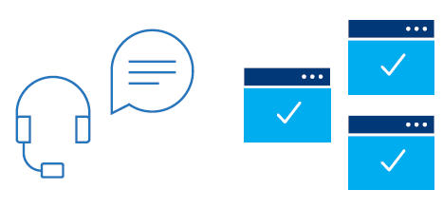
Microsoft Bot Framework
Microsoft Bot Framework enables you to build and connect intelligent bots to interact with your users naturally wherever they are — from your website or app to Cortana, Skype, Teams, Office 365 mail, Slack, Facebook Messenger Skype for Business and more...
Open source Bot Builder SDKs allow you to build simple to sophisticated dialogs; Cognitive Services enable your bot to see, hear, interpret and interact in more human ways

Slide 31
Bot Framework V4
GA - C# and Java Script
C# support .NET Core
Python and Java - still in preview
Incorporates learnings from V3
Open, Modular and extensible architecture
Agile and customizable dialog system
Share the same implementation across C#, Java Script, Java and Python
Rich visual controls (cards, buttons, images, videos, adaptive cards)
Seamless integration with Azure and Cognitive Services
Modern toolchain (streamline development and deployment)
Open Source and rich ecosystem

Slide 32
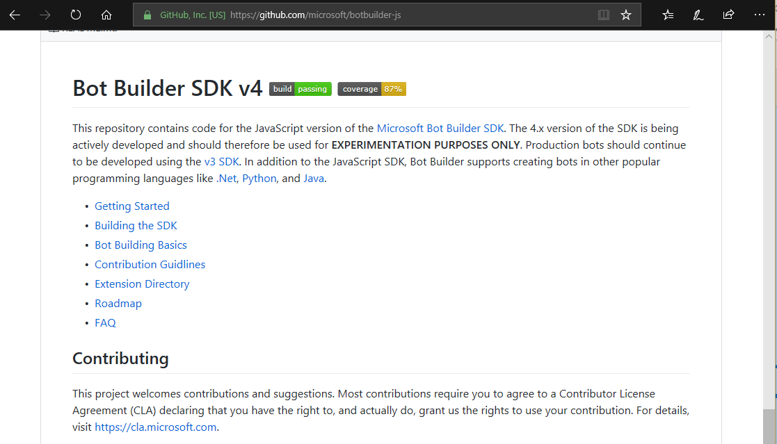
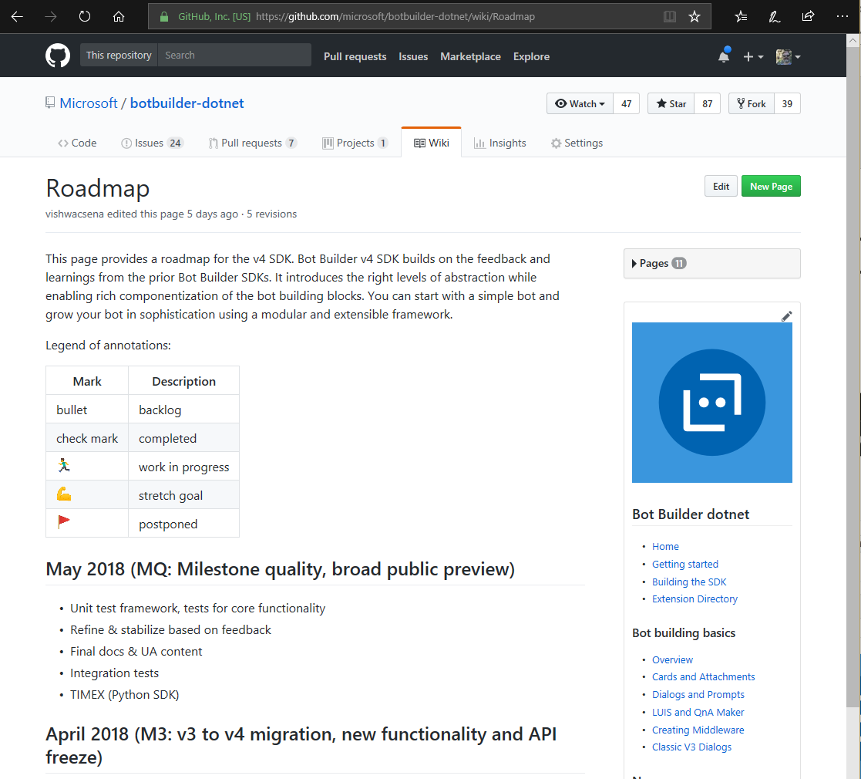
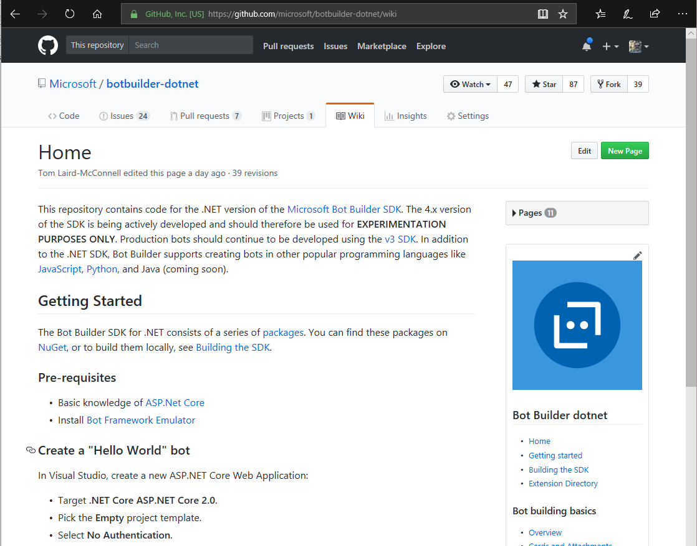







Bot Framework – Open Source Project
10 Public Repos
By developers for developers
300K+ Developers
800K+ SDK Downloads
Open Source
Community Engagement
Thriving Ecosystem
SDK V4: C#, JavaScript, Python, Java
SDK V3 (C#, JavaScript)
CLI Tools
Emulator
WebChat Control
Documentation
BotBuilder-Samples
10+ Public Repos
SDK V4: C#, JavaScript, Python, Java
SDK V3 (C#, JavaScript)
CLI Tools
Emulator
WebChat Control
Documentation
BotBuilder-Samples (more than 60 samples…)
Notes:
https://azure.microsoft.com/en-us/blog/build-conversational-experiences-with-microsoft-bot-framework/
https://blog.botframework.com/2018/11/06/announcing-bot-framework-sdk-and-tools-4-1-release/

Slide 33
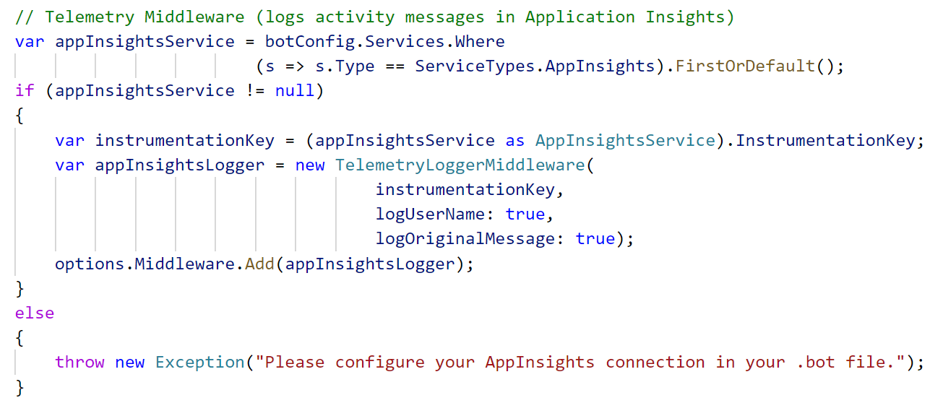
SDK Extensibility through Middleware
Uniform concept across platforms
Annotating / processing / transforming activities
Adding Telemetry (App Insights) middleware
Standard Middleware Calling Pattern
Request
Middleware 1
// logic
Next();
//more logic
Middleware 2
// logic
//more logic
Response
Find this sample on https://github.com/Microsoft/BotBuilder-Samples

Slide 34
Microsoft Bot Framework

Slide 35
















Channels
Virtual Assistant
Your brand, your assistant
Knowledge
Sources
General Knowledge
Manuals (PDF)
AI Capabilities
Data Sources
Azure Bot
Services
Conversation Skills (Customisable)
User
Input
Speech
Virtual Assistant
Your Brand
Your Personality
Dialogs
Language Model
Mail
Tasks
Tap
Adaptive Cards
Point of
Interest
Calendar
Linked
Accounts
Automotive
Hospitality
Type
Speak
QnA
Vision
Custom
Language Understanding
Devices
3rd Party
Assistants
APIs
Productivity
1st/3rd Party
IoT Edge
Directory

Slide 36
Modelling your conversation
Roll your own
state management etc.
Multi layered conversations
Bespoke
Dialogs
Data capture,
“Web forms” scenarios
Flexibility
FormFlow
FAQs,
command & control
QnA
Effort to implement
Notes:
Bespoke – maßgeschneidert

Slide 37

Conversational mechanisms
Text, with optional media attachments
Traditional chat, can contain media attachments (e.g., image, video, audio, file)
Input prompts
Suggested actions: Buttons, numbered items in a list, etc.
Rich cards, rendered as a list or carousel
Images, buttons, audio, animations, video, user sign-in, etc.
Hero | Audio | Animation | Thumbnail | Receipt | Sign In | Video | Adaptive | Purchase
Speech
Text-based chat using Speech Recognition & Synthesis (TTS)

Slide 38

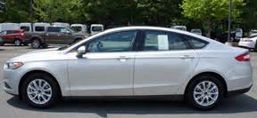
An intelligent bot in action
Interact in personal, natural ways
Smart Recommendations, personalization, immersive experiences
Litware Insurance
Recognize images with Computer Vision
Greeting
Prompt with choice
Infuse processes with intelligence
Dynamics CRM
Integrate with Dynamics CRM to surface relevant suggestions
Generate quotes based on smart insights
Prompt for text
Natural language parsing to identify intent
(translation when necessary)
Capitalize on hidden insights beyond your data
Advanced Analytics, Machine Learning, Data Enrichment
Analyze sentiment
Live agent handoff
Cognitive Services enable interaction through voice or text
Litware Insurance Bot
Has joined the conversation
Type a message…
Hi! How can I help you today?
Where is Litware based?
Litware has an office in Redmond, Washington.
Can I help with anything else?
I need to buy insurance
No problem! Are you an existing customer?
Yes
What is your name?
Shelly Smith
What are the last 4 digits of your social security number?
1234
I’ve found your existing policies. If you insure your new car with us, you’ll get a 10% multi-policy discount.
I can also see that your daughter on your other policy just turned 16 years old. Should I include her on this one as well?
Yes
No
No
What kind of vehicle are you adding today?
Ford
Dodge
Toyota
Ford
Please upload a picture of the vehicle.
Congratulations on your new 2016 Ford Fusion! Now generating quote…
We can provide comprehensive insurance for $124.49 a month. Would you like to proceed with enrolling in coverage?
No, I am unsatisfied
Ok, I’ll connect you with an agent who can explain your coverage options.
Notes:
When an intelligent bot is in action, several things are being managed behind the scenes. The Litware Insurance bot demo we took a look at a couple minutes ago is a great example. Let’s take a “behind the scenes” look at what was happening.
<click>
In order to interact in personal, natural ways, the Litware bot had to be able to recognize simple parts of a conversation, like greetings, and respond with the appropriate information or prompt for response. Natural language parsing capabilities assisted the Litware bot in this process, and can translate between languages when necessary with the help of the Translator Cognitive Services API.
<click>
Intelligent bots are capable of prompting the user with choices, and making decisions about where to direct the conversation next based on the user’s response. An example of this in the Litware demo is when Litware bot prompts Shelly with the choice of adding her daughter to her insurance policy after recognizing her account. When enabled with Microsoft Cognitive Services like Language Understanding, Speech Recognition, and Custom Recognition, bots can interact through either voice or text. Throughout this conversation, the Litware bot used Dynamics CRM to track customer information and surface questions and information appropriately, infusing the conversation process with intelligence.
<click>
Also behind the scenes, Litware bot was helping capitalize on hidden insights beyond Litware’s data by integrating the information being gathered with Microsoft’s advanced analytics, Machine Learning, and data enrichment tools. Additional Cognitive Services offerings like Computer Vision powered our bot’s ability to recognize Shelly’s image of her new car to detect information.
Advanced Analytics and Machine Learning enabled Litware bot to tap into an enriched pricing information database when it was time to surface a quote in this conversation. As the information from this and other unique conversations is compiled and the database grows, Litware bot gets better at generating quotes and offers for customers like the one we saw generated for Shelly today. When Shelly wasn’t satisfied with her quote, the Text Analytics API helped Litware bot detect her sentiment regarding the quote, which led to a handoff with a human agent to continue the conversation.
Transition: Although we’ve demonstrated the usefulness of bots, there are some misconceptions about the technology that should be confronted.
<click>

Slide 39
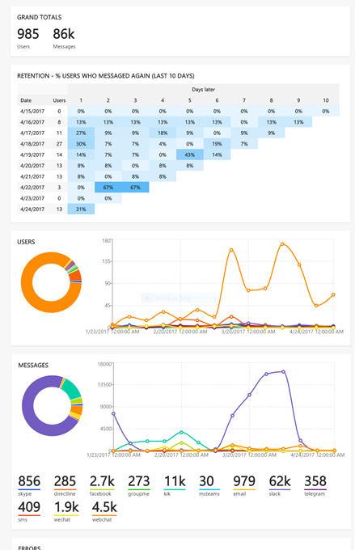
Continuous Improvement
Instrumentation provided by App Insights; added by default in Bot Service
Extend instrumentation through AI SDK
If you are not building bots that will actually be used, then you are not building bots

Slide 40
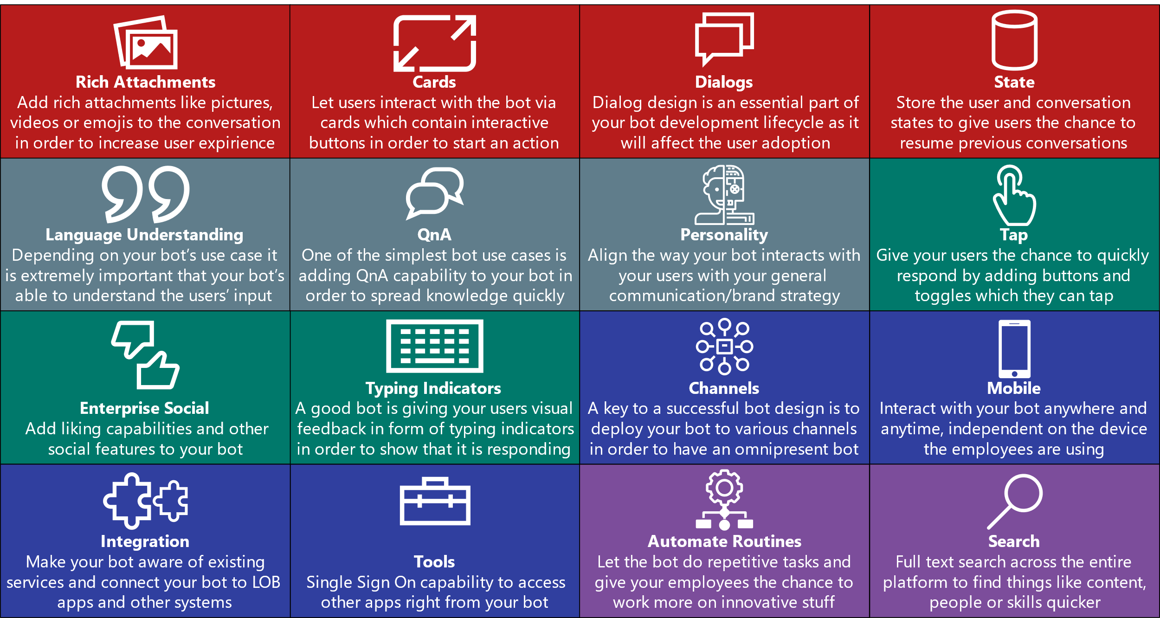
Key Parts of an Enterprise Bot Design

Slide 41
And you gotta have some sort of intelligence…

Slide 42
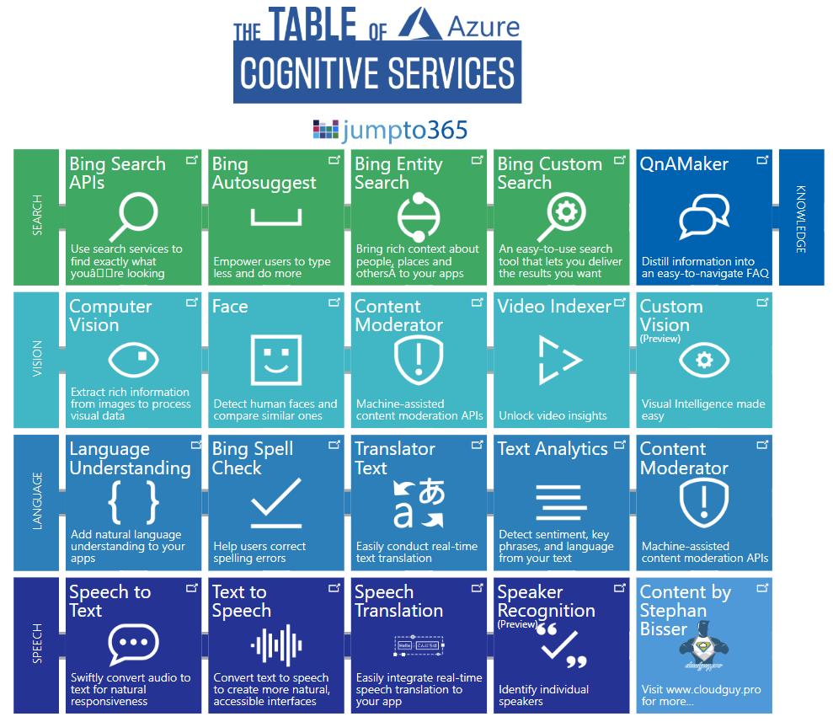
https://ai.jumpto365.com/

Slide 43
Language & Knowledge

Slide 44
How do I interact with my users in other languages?
How do I setup a FAQ service?
How do I detect the users’ intents?
Language
Dynamics 365
Skype
Knowledge
Speech
Browser
Azure Bot Service
Cognitive Services
Vision
Cortana
Web
Azure ML
Cognitive Toolkit

Slide 45
Text Analytics
Language detection
Over 120 languages supported
Supports basic NLP scenarios
Up to 1000 1K docs per request
Call directly from Power BI & Data Lake U-SQL; SDK supports .NET Standard + Android
Not PAYG: paid tier starts at $150 per month with 100K txns
Example
I had a wonderful experience! The rooms were wonderful and the staff was helpful.
{ "name": "English", "score": 1.0 }
Sentiment analysis
From 0 (-ve) - 1 (+ve); supports 15 languages
{ "score": 0.99979335069656372 }
Key phrase extraction
Main talking points; supports 5 languages
{ "keyPhrases": [ "wonderful experience", "staff", "rooms" ] }

Slide 46

Translator (Text)
Client app or webpage
Cet outil de traduction est un moyen facile d'étendre la portée de vos contenus internes et externes.
此翻译工具是可以轻松地扩展您的内部和外部内容的覆盖范围。
Cloud-based open API service
Supports 60+ languages
Powers Bing, Edge, mobile apps, Office, Yammer, VS, Skype, eBay, Etsy, HP, …
XML-based API ☹; supports detect, bulk operations
Pay-per-character (2M free)
WEB API

Slide 47
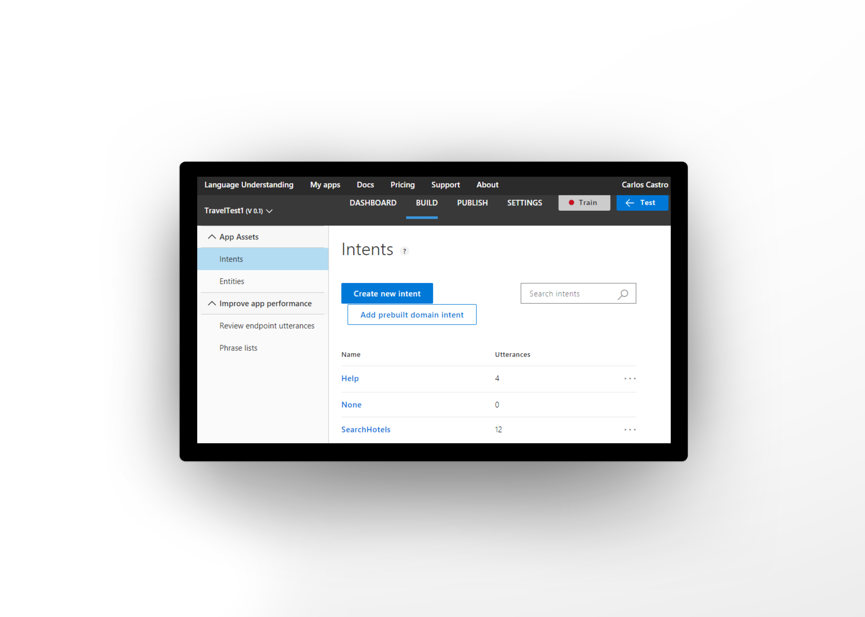
Language Understanding (LUIS)
Quickly build a custom language solution
Add natural language to your apps
Machine learning-based service to build natural language into apps, bots, and IoT devices. Quickly create enterprise-ready, custom models that continuously improve.
New People and Geography entity recognizers
CLI tools and v4 SDK integration
CSA STAR, ISO 27001, ISO 27018, HIPAA and PCI DSS Compliance
Always learning & improving
Enterprise Grade, available worldwide

Slide 48
Language Understanding Example
Book a hotel in Seattle.
Intent = BookHotel
Entity = Seattle

Slide 49
Language Understanding Example
{
"query": "Book a hotel in Seattle.",
"topScoringIntent": {
"intent": "BookHotel",
"score": 0.921233
},
"entities": [
{
"entity":"Seattle",
"type": "Location",
"startIndex": 10,
"endIndex": 13,
"score": 0.7615982
}
]
}

Slide 50
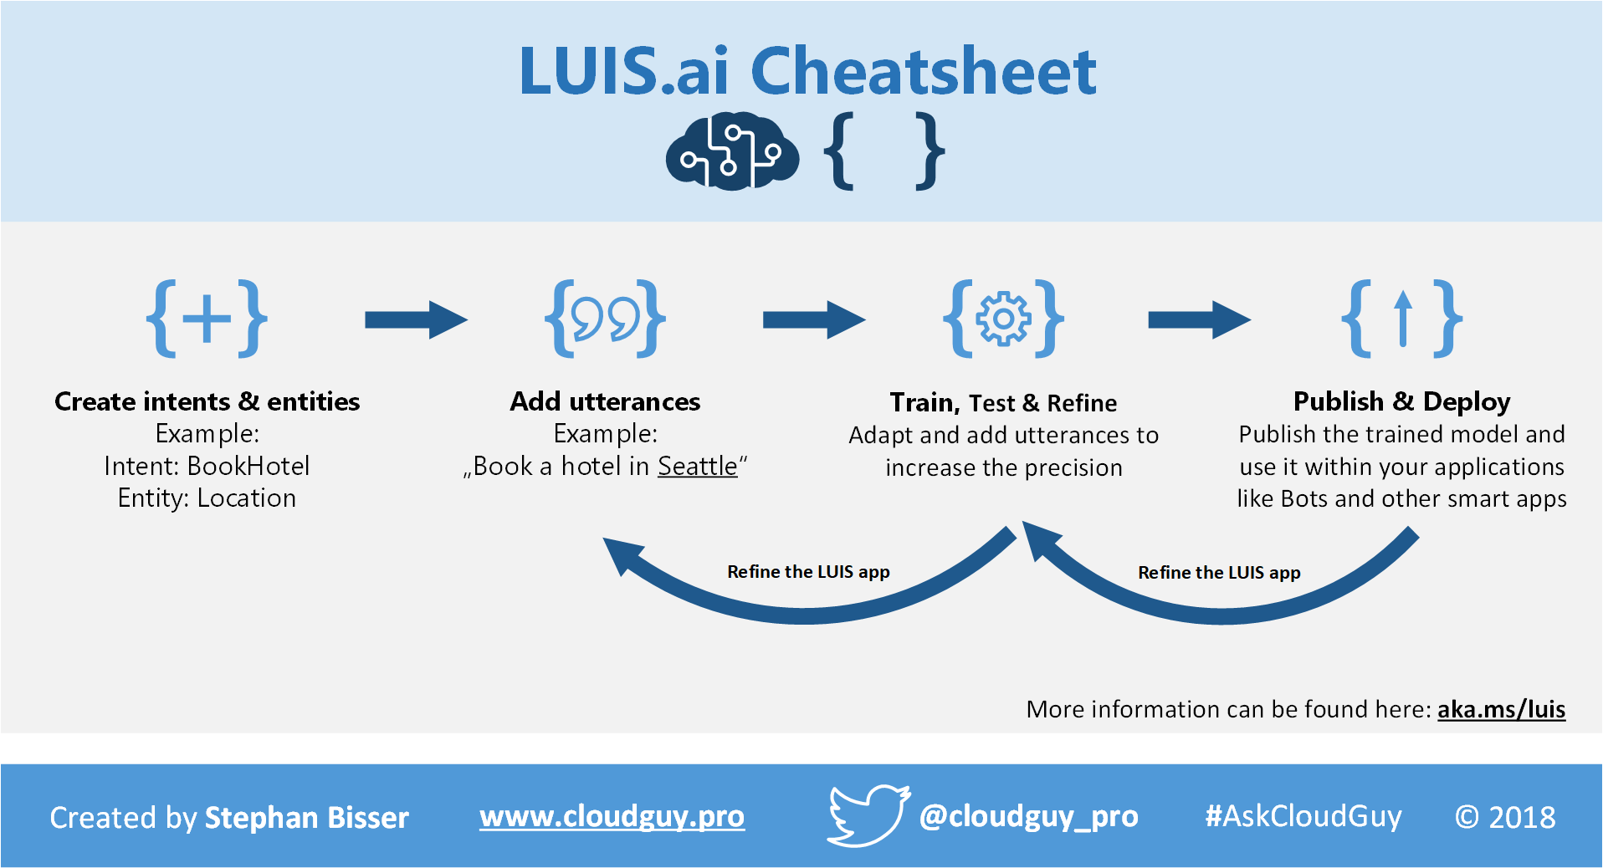

Slide 51
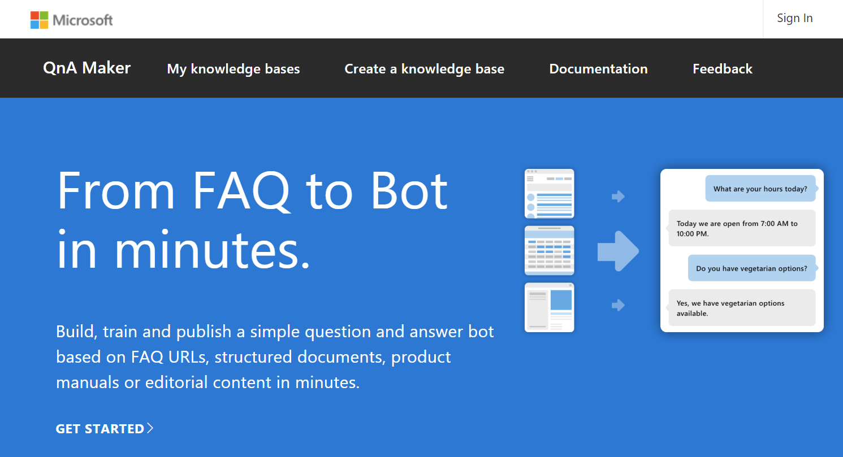
QnA Maker
Data - Aggregate and extract knowledge from non structured data
Architecture. The data and runtime hosted in your Azure subscription.
Data privacy and compliance. QnA data is hosted within your Azure compliance boundary.
Seamless chit-chat integration with personalities like: Profesional; Friend; Comic.
Azure Application Insights integration.

Slide 52
QnAMaker
Extract questions & answers
Add new or from URLs, docs, editorial content
Train a NLP Q&A model using new & existing FAQs
Actively learns: offers closest match to user & then improves
NuGet package available for Bot Framework; don’t need to use it with bots though
Need more? Look to Azure Search and integrate manually
Diff, train, test, publish
See it in action then publish an endpoint
Integrate it with your app
REST API, add to a bot, or generate a new bot
switch (activity.GetActivityType())
{
case ActivityTypes.Message:
await Conversation.SendAsync (activity, () => new BasicQnAMakerDialog());
break;
...
}

Slide 53
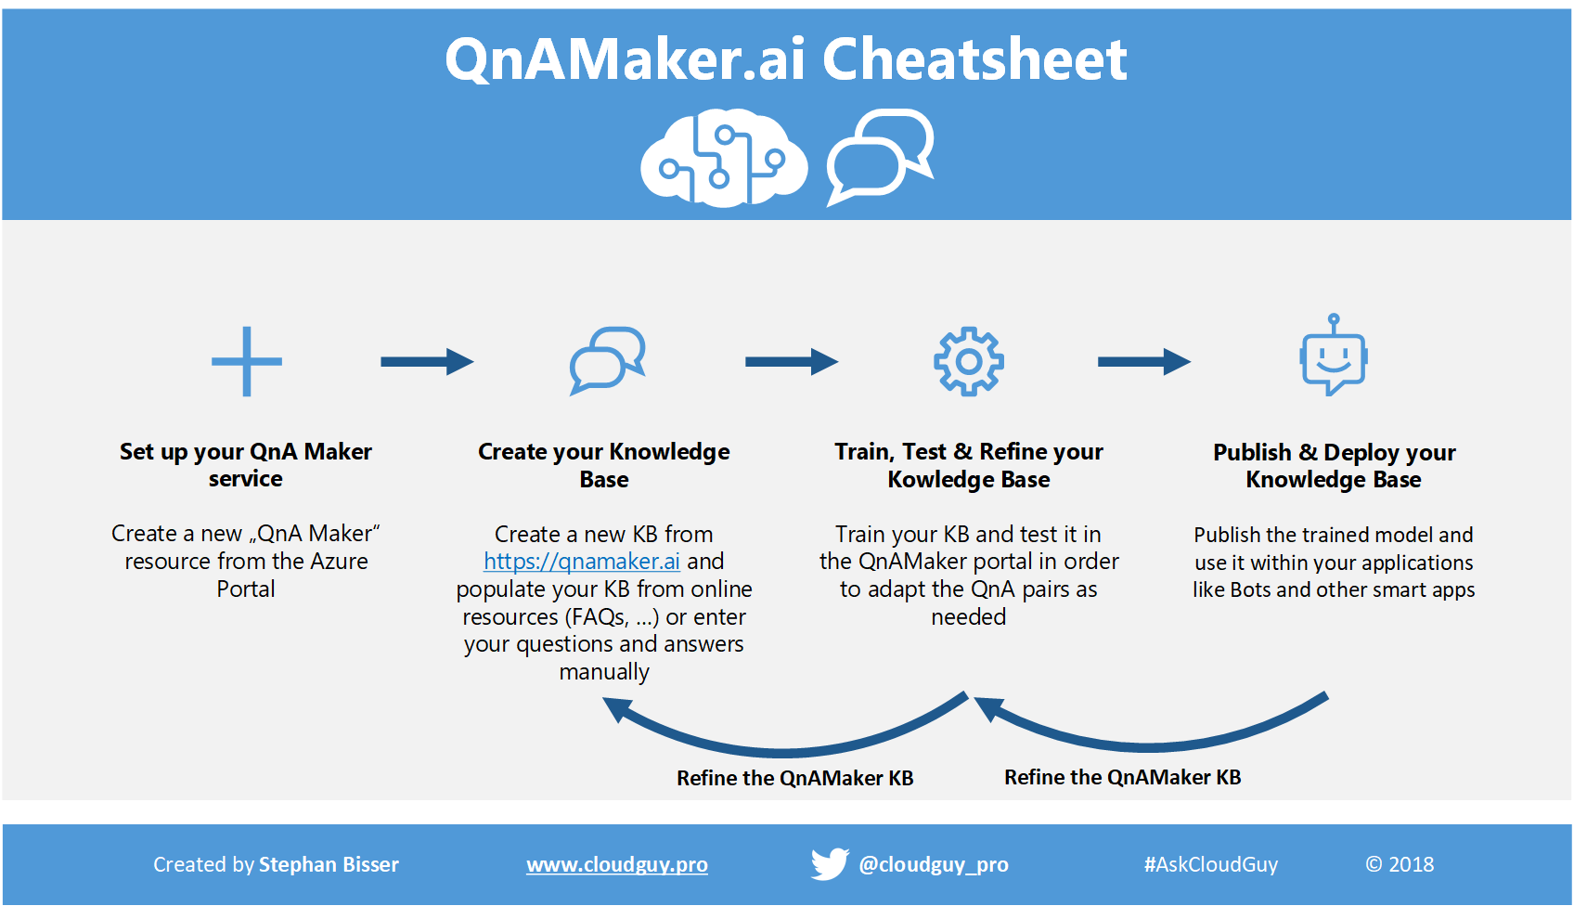

Slide 54
What do I use then?
EASY
MODERATE
ADVANCED
Text Analytics
Start to understand unstructured content
Translator
Access languages of 95% of the world’s GDP
Bing Spell Check
Make better NLP pipelines with cleaner data
QnAMaker
Add question & answer pairs
to a KB and consume it easily
LUIS
Some assembly required: train and improve your models
Web Language Model
Word breaking is easy; probabilities are for more sophisticated pipelines
Linguistic Analysis
Go beyond Text Analytics to pull out key aspects or even derive meaning

Slide 55
How do I interact with my users in other languages? Translator (Text)
How do I setup a FAQ service?
QnAMaker
How do I detect the users’ intents?
Language Understanding (LUIS)
Language
Dynamics 365
Skype
Knowledge
Speech
Browser
Azure Bot Service
Cognitive Services
Vision
Cortana
Web
Azure ML
Cognitive Toolkit

Slide 56
Vision

Slide 57
How do I understand the contents of the images my users upload?
How do I distinguish between different car types?
How do I recognize my users?
Language
Dynamics 365
Skype
Knowledge
Speech
Browser
Azure Bot Service
Cognitive Services
Vision
Cortana
Web
Azure ML
Cognitive Toolkit

Slide 58
Computer Vision
Analyze
Tags, categories, faces, descriptions, colors
General purpose image analysis
Analyze in multiple dimensions through single API call; or use scoped operations
Pass images as binary content or URLs; JPG, PNG, GIF, BMP
Tags etc. available in EN, ZH
Not designed for object classification or domain-specific concepts
Extract text
Machine generated, handwriting (preview)
Domain-specific
Celebrities, landmarks; flag adult content
Thumbnails
Crop to region of interest and aspect ratio

Slide 59
Computer Vision: Analyze
Face
"faces": [ { "age": 36, "gender": "Male", "faceRectangle": { "left": 298, "top": 133, "width": 121, "height": 121 } } ]

Slide 60
Computer Vision: Extract text
Handwriting
Still in preview and only supports EN
Asynchronous processing model
Supports text on whiteboards, paper, sticky notes to digitize different inputs
Also supports rotation correction
{ "status": "Succeeded",
"succeeded": true,
"failed": false,
"finished": true,
"recognitionResult": {
"lines": [
{
"boundingBox": [ 354, 196, ... ],
"text": "Be yourself",
"words": [
{
"boundingBox": [ ... ],
"text": "Be"
},
{
"boundingBox": [ ... ],
"text": "yourself" ...

Slide 61
What are we going to build today?

Slide 62
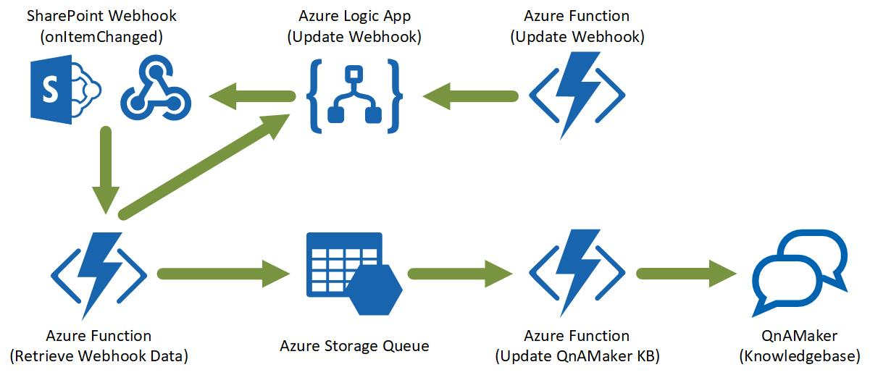
QnA Bot with auto-update

Slide 63
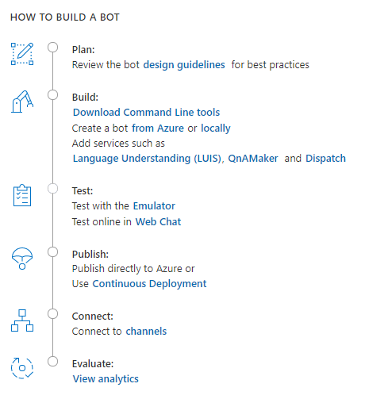
How to build a bot
Plan
Build
Test
Publish
Connect
Evaluate

Slide 64
The Lifecycle of your Project
Comprehensive framework for the lifecycle of your project
Plan
Build
Test
Publish
Connect
Evaluate
Author Dialogs
Design Cards
Visualize
Bot Builder SDK
Cognitive Services
Getting Started Templates
Emulator​
Application Insights
Conversation Transcripts
DevOps Tools
Azure
BYO Web Host
WebChat
Cortana
Skype, FB
+
Custom (DirectLine)
Application Insights
LUIS Suggestions

Slide 65
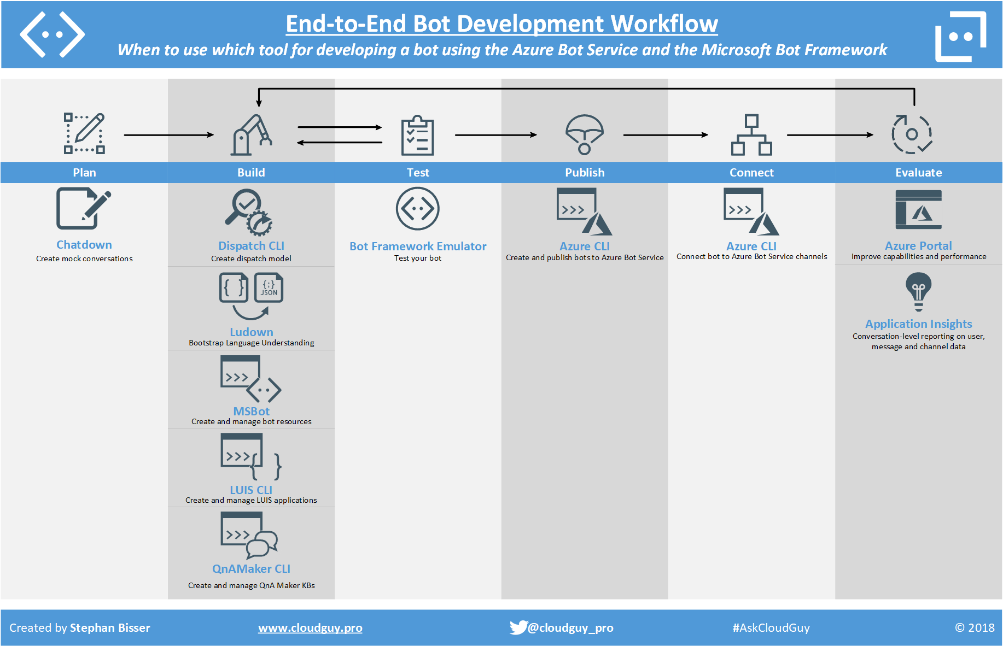

Slide 66
Development Lifecycle: Plan
Take time to Plan you build.
Plan
Build
Test
Publish
Connect
Evaluate
Notes:
Plan phase: - dialog flow - Bot tools V4 (CLI, Dispatcher) - Chatdown (happy - non happy path) - adaptive cards (azurewebsite + how it works) - Our Scenario: How are we going to do it.

Slide 67
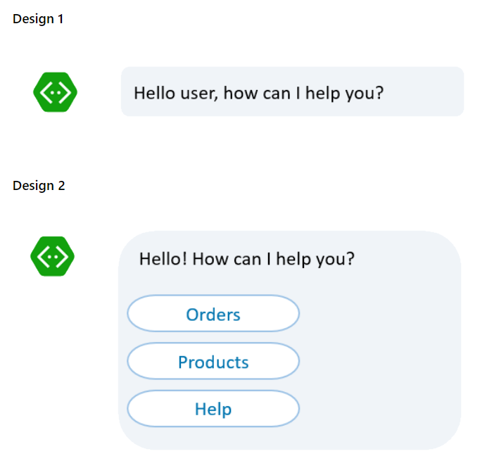
Language versus menus

Slide 68
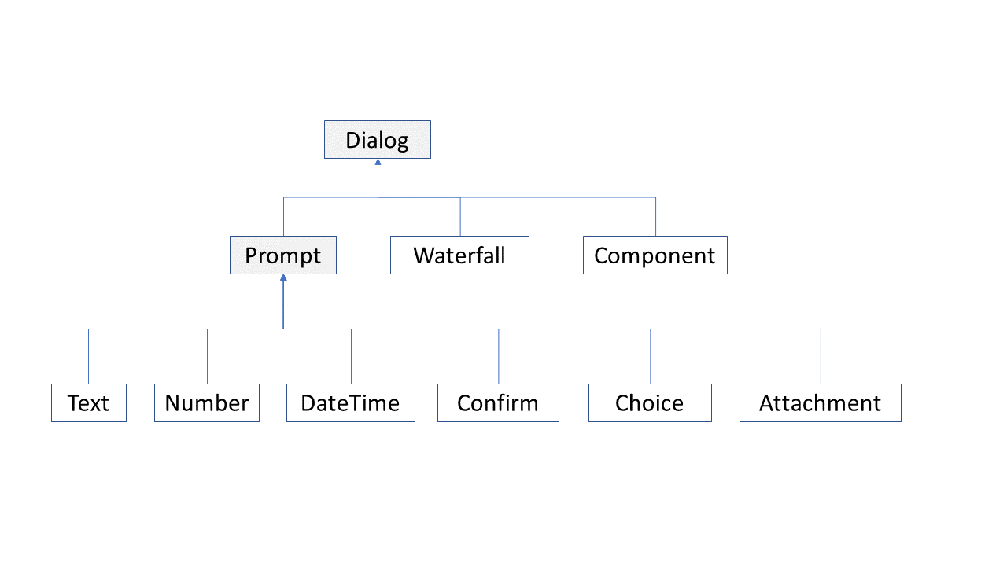
Dialog Management

Slide 69
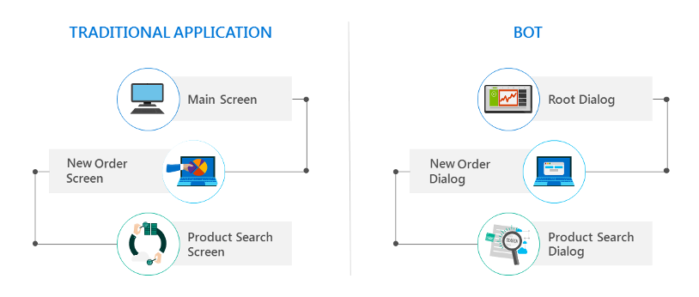
Procedural conversation flow

Slide 70
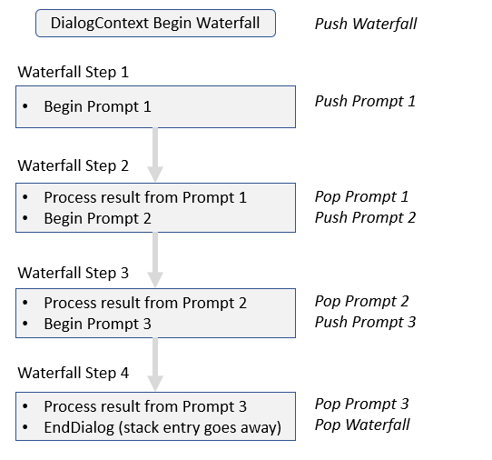
Waterfall Dialogs

Slide 71
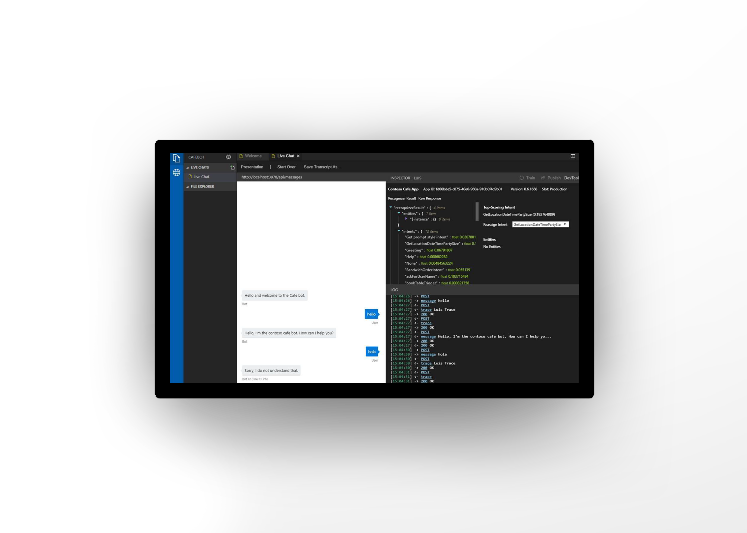
ChatDown
Conversation Modelling
Mocking Conversation
user=vishwac
bot=cafebot
user:What are your locations
bot:We have Cafe locations in Redmond, Seattle, Renton and Bellevue
user:who is your CEO
bot:Joshua Newmann is the CEO of Contoso Cafe
user:Are you hiring
bot:You bet, we always are. Please visit http://contosocafe.com/careers

Slide 72
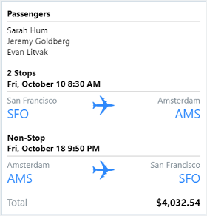
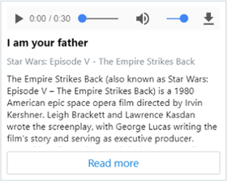
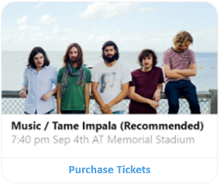
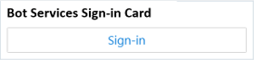
Cards
Adaptive Cards
Audio Cards
Hero Cards
SignIn Cards
Notes:
https://docs.microsoft.com/en-us/azure/bot-service/bot-service-design-user-experience?view=azure-bot-service-4.0

Slide 73
Development Lifecycle: Build
Building
Plan
Build
Test
Publish
Connect
Evaluate

Slide 74
Language
LUIS
QnA
Modelling: Language Understanding
# Greeting
- Hi
- Hello
- Good morning
# BookFlight
book a flight from {fromCity=new york} to {toCity=seattle}
### ? What can you do?
```markdown
I can greet and provide help
```
Creating: Language Understanding
# Import LUIS model
luis import version --in jSONApp.json
# Train our LUIS model from LuDown
luis train version
# Publish the luis model
luis publish version
# Ask for a prediction
luis query -q <querytext> --region <region>

Slide 75
Development Lifecycle: Test
Plan
Build
Test
Publish
Connect
Evaluate

Slide 76
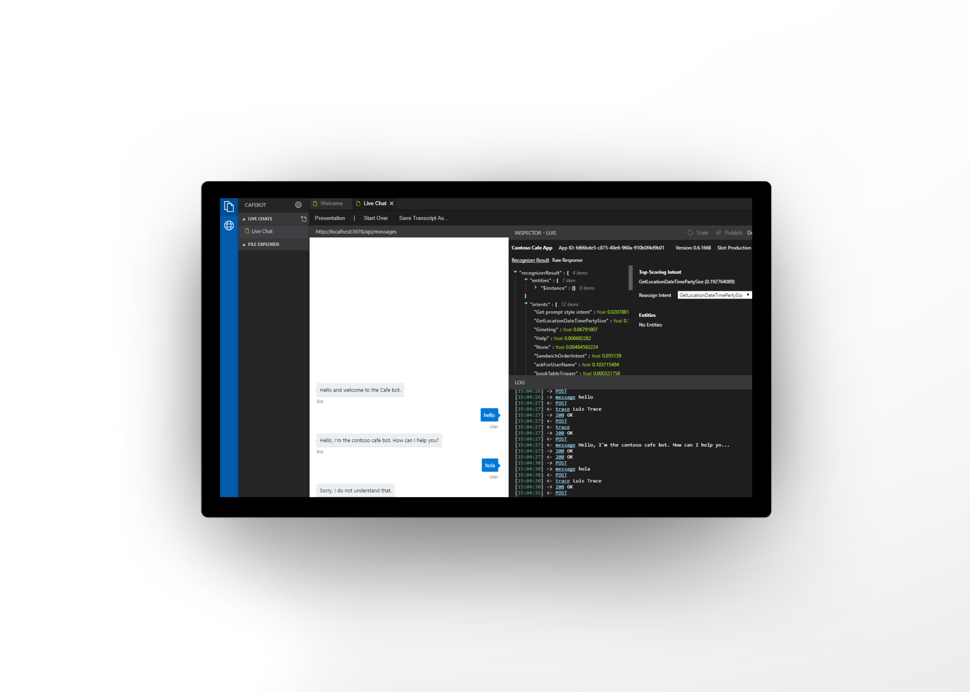
Bot Framework Emulator
Test and debug bots locally and in cloud
View and manage bot’s services
Built in inspectors for LUIS and QnA
Train and publish directly from emulator
Extensible plugins for inspectors

Slide 77
Development Lifecycle: Publish
Plan
Build
Test
Publish
Connect
Evaluate

Slide 78
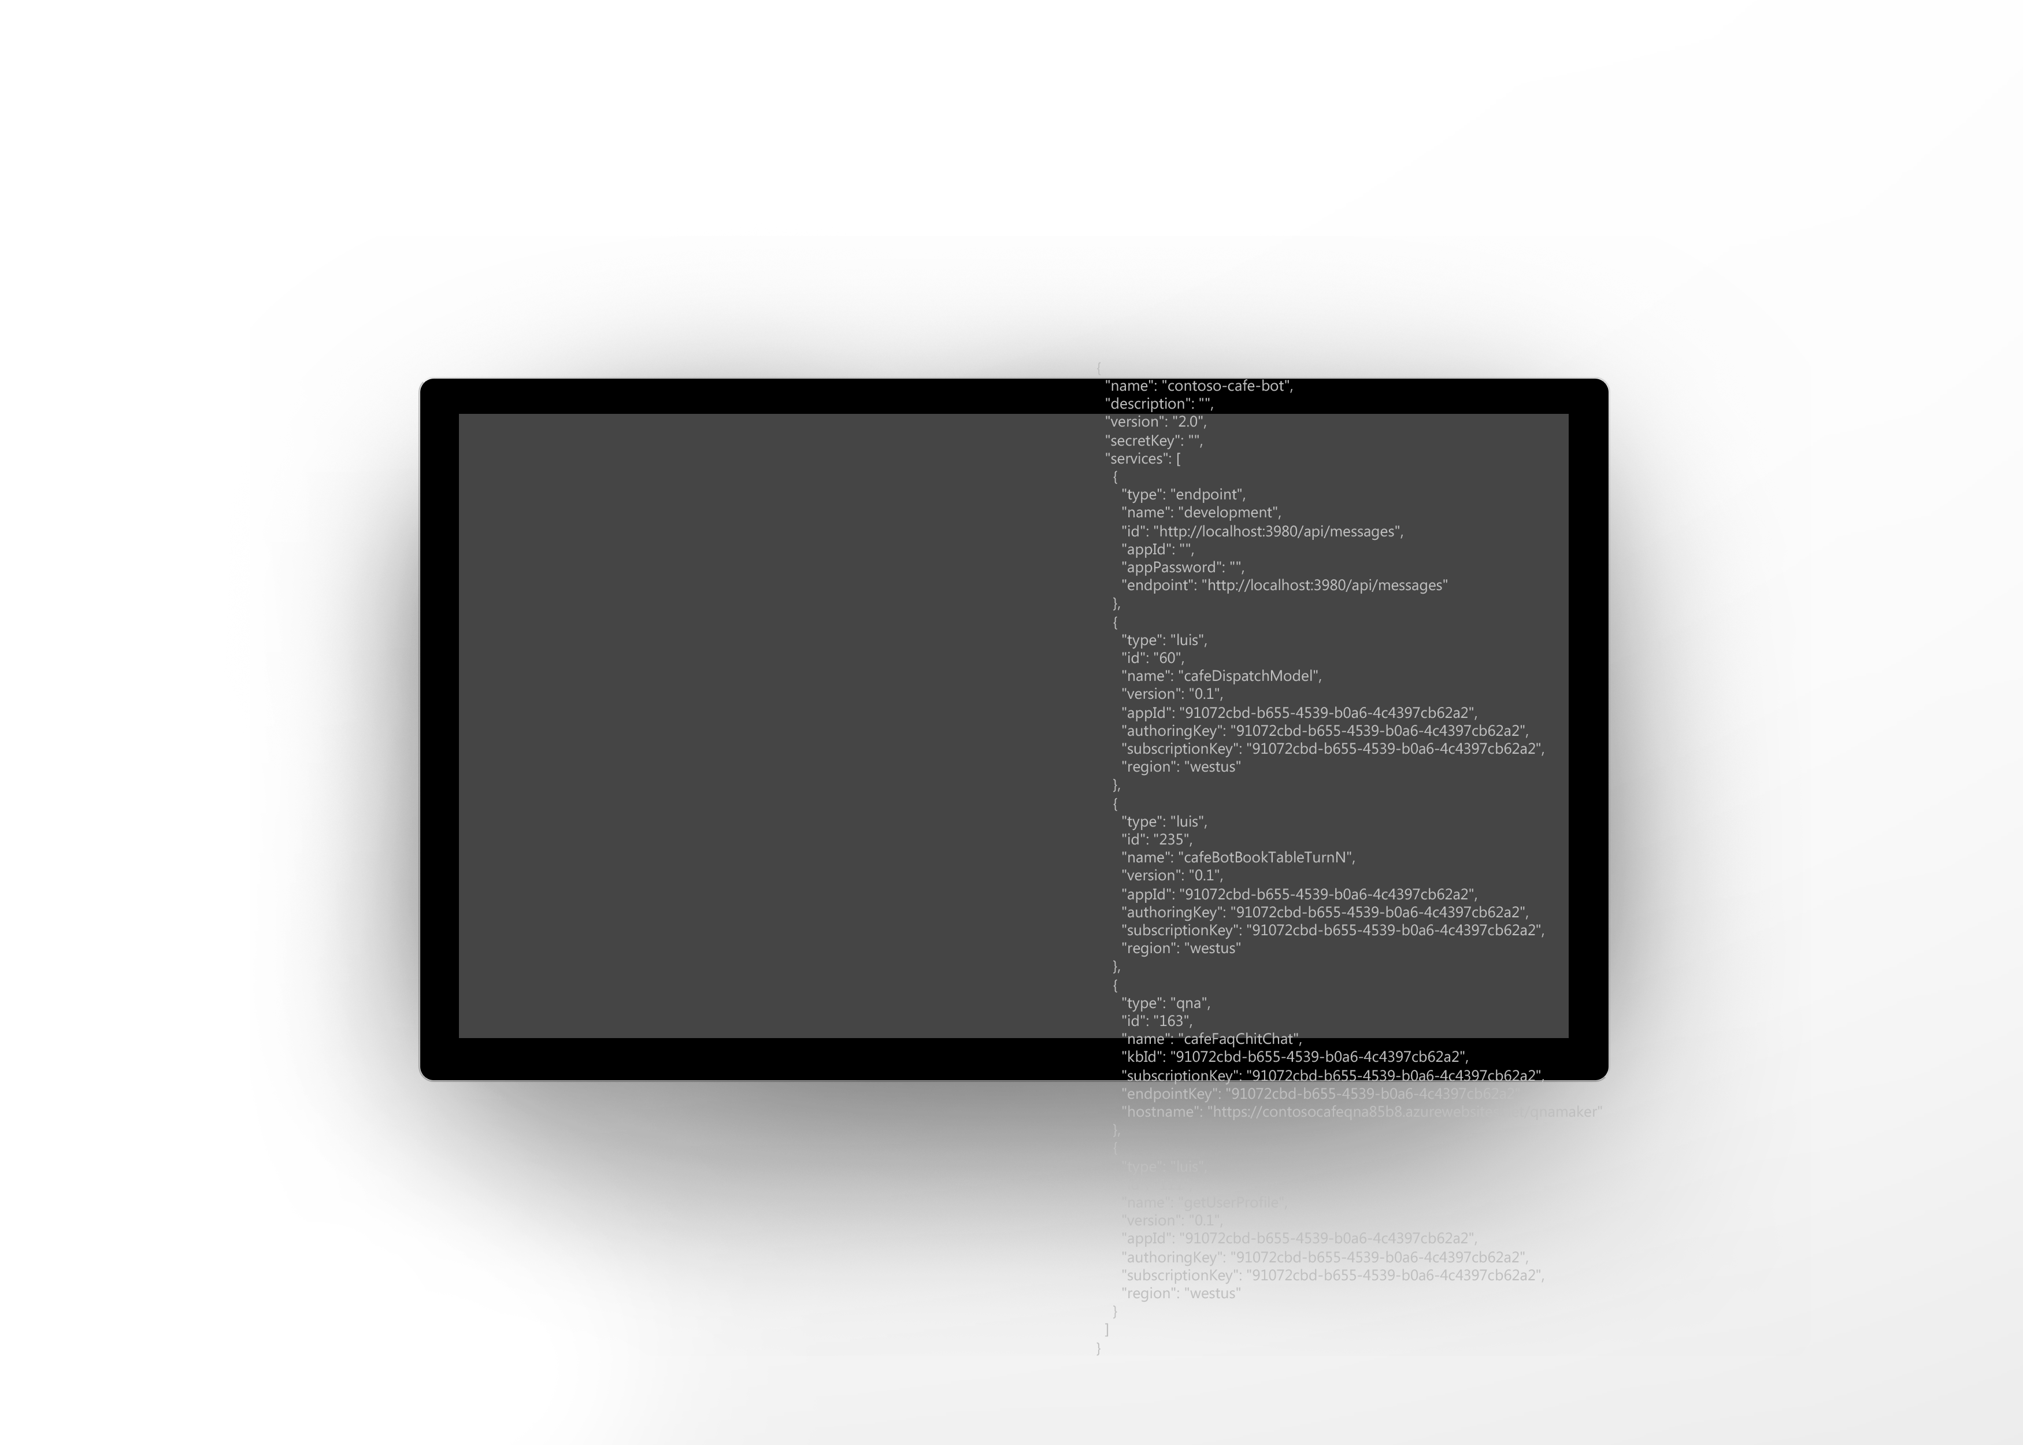
.bot File – Your Bot’s Services Manifest
A collection of services used by your bots
Bootstraps your bot
Integrates with Bot Framework Emulator and toolchain
One place to manage services
.bot file example
Localhost
Azure Bot Service
LUIS.AI
QnA Makrer
Dispatch
Azure Application Insights
Azure Blob Storage
Azure Cosmos DB

Slide 79
Development Lifecycle: Connect
Plan
Build
Test
Publish
Connect
Evaluate

Slide 80
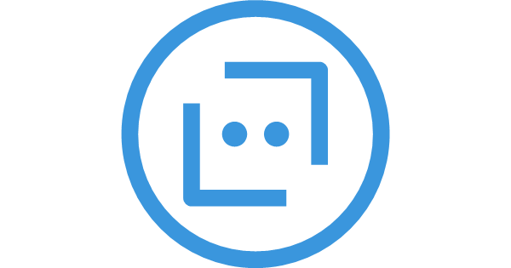
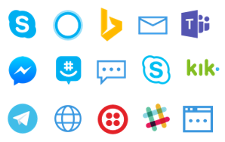






Az bot
Create bots and manage channels
# Create a web app bot
Az bot create –kind webapp –n “build2018bot”
# Manage channel registration from command line
Az bot skype create
Az bot msteams create
Az bot email create –-email <email> --password <password>
Az bot directline create
# Download bot source to work locally
Az bot download <path>
# Publish your bot source to a bot instance
Az bot publish

Slide 81
Development Lifecycle: Evaluate
Plan
Build
Test
Publish
Connect
Evaluate

Slide 82
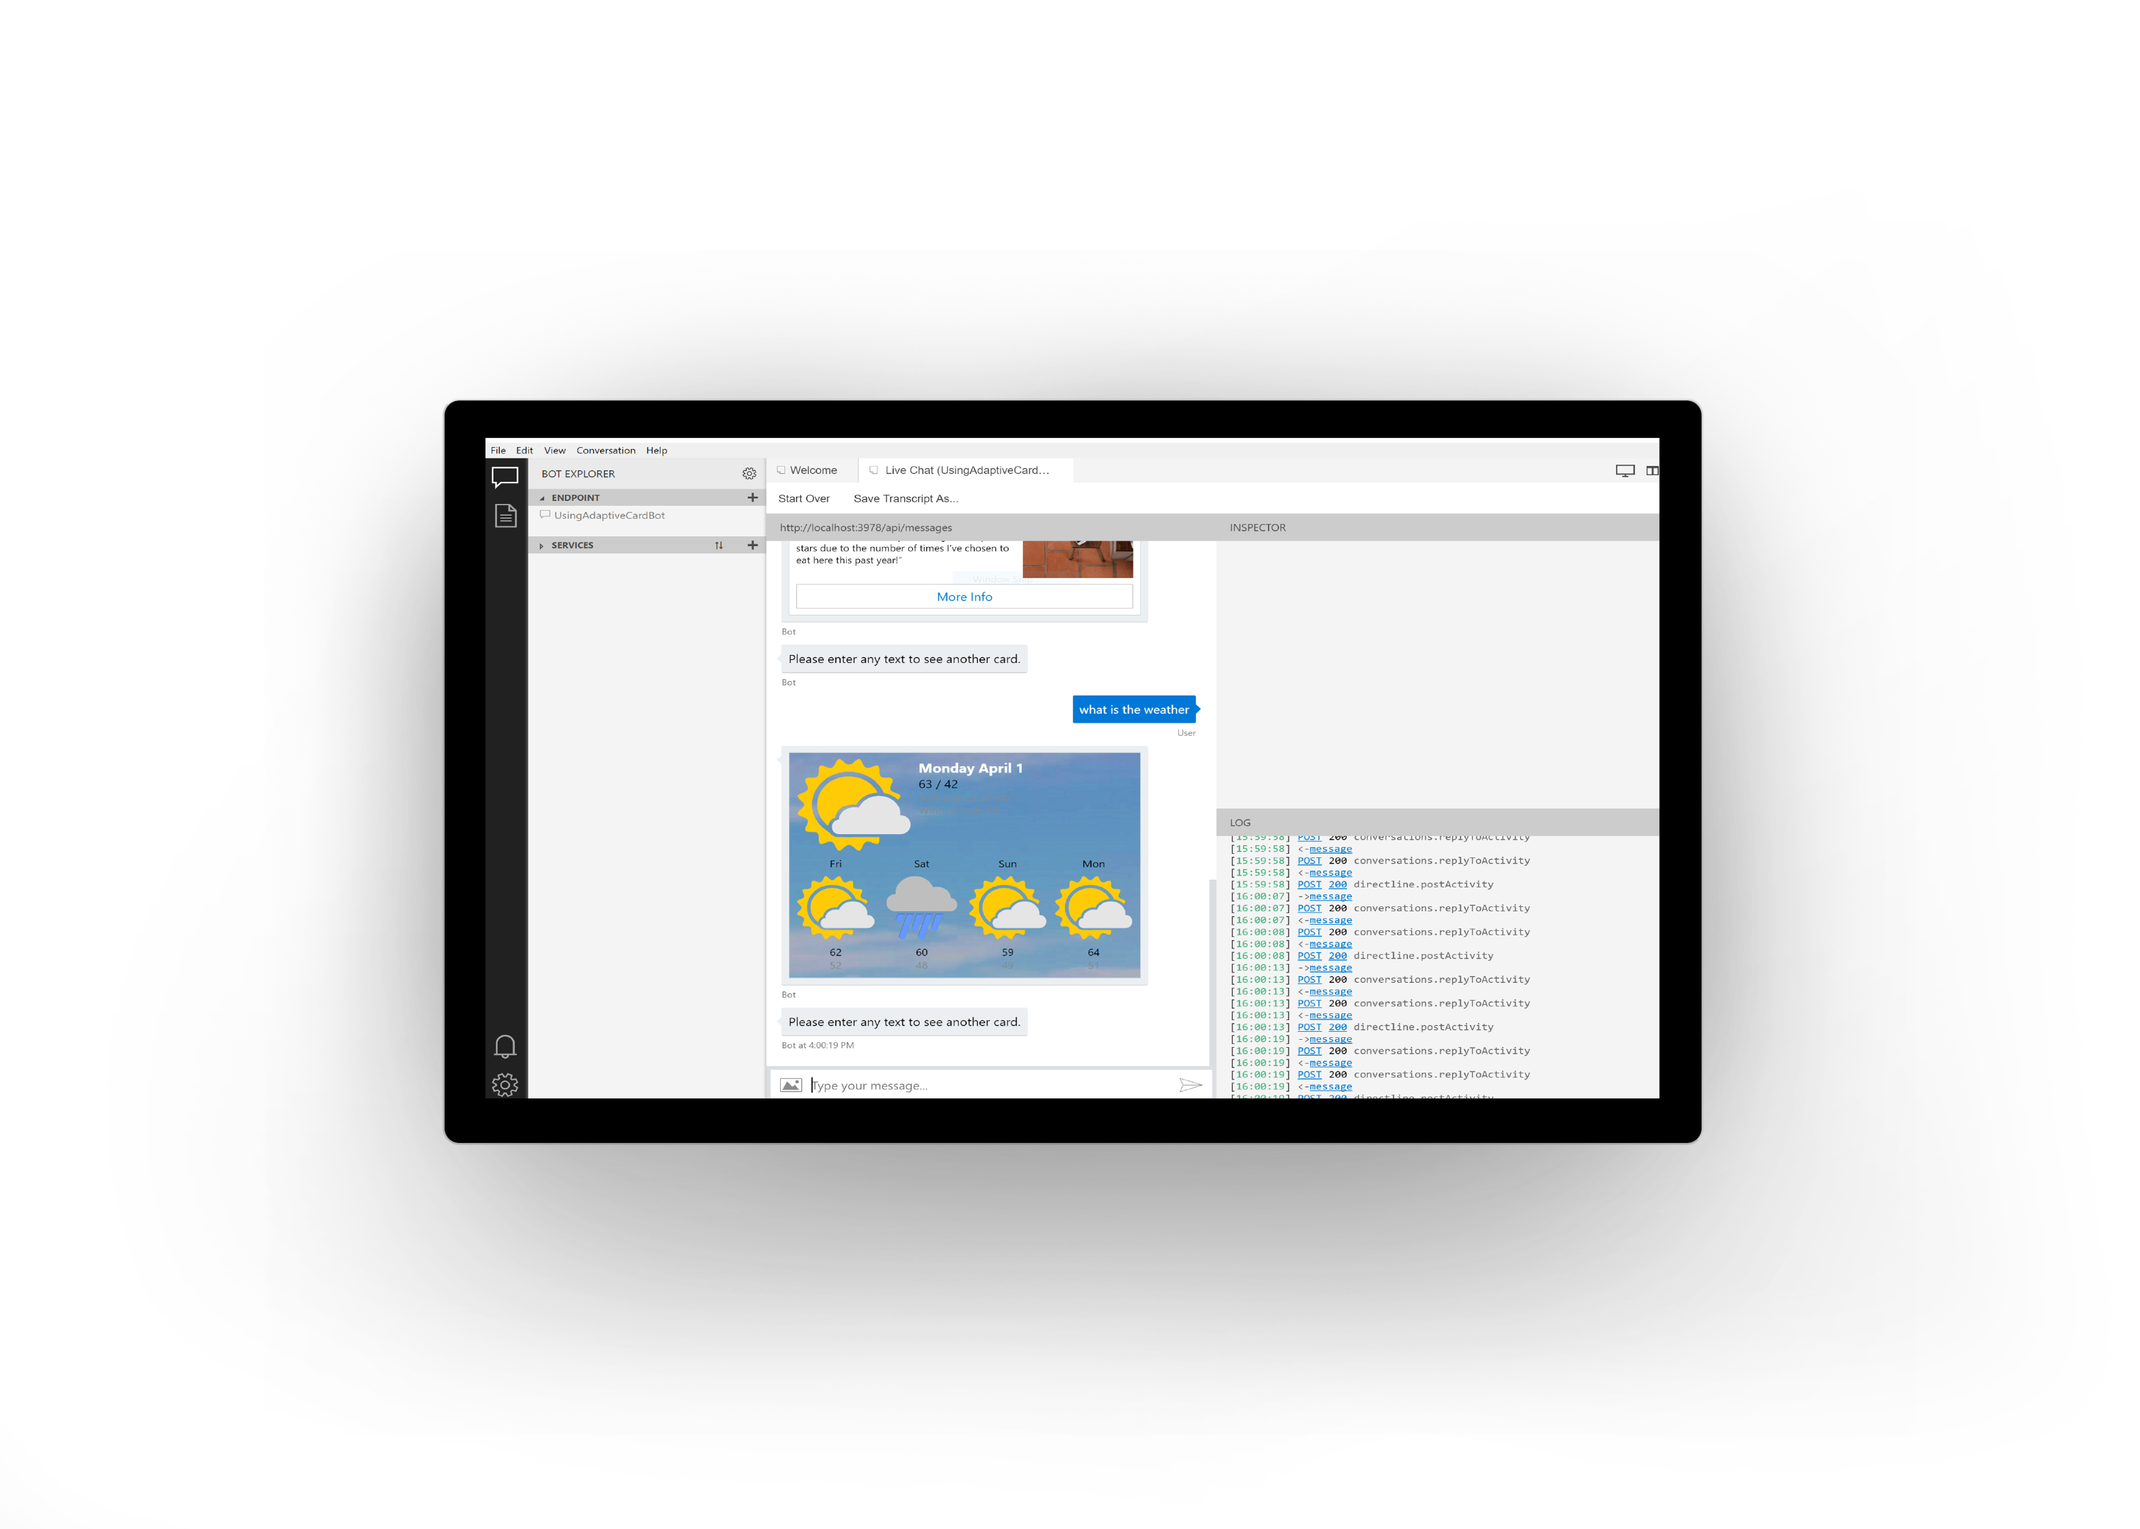
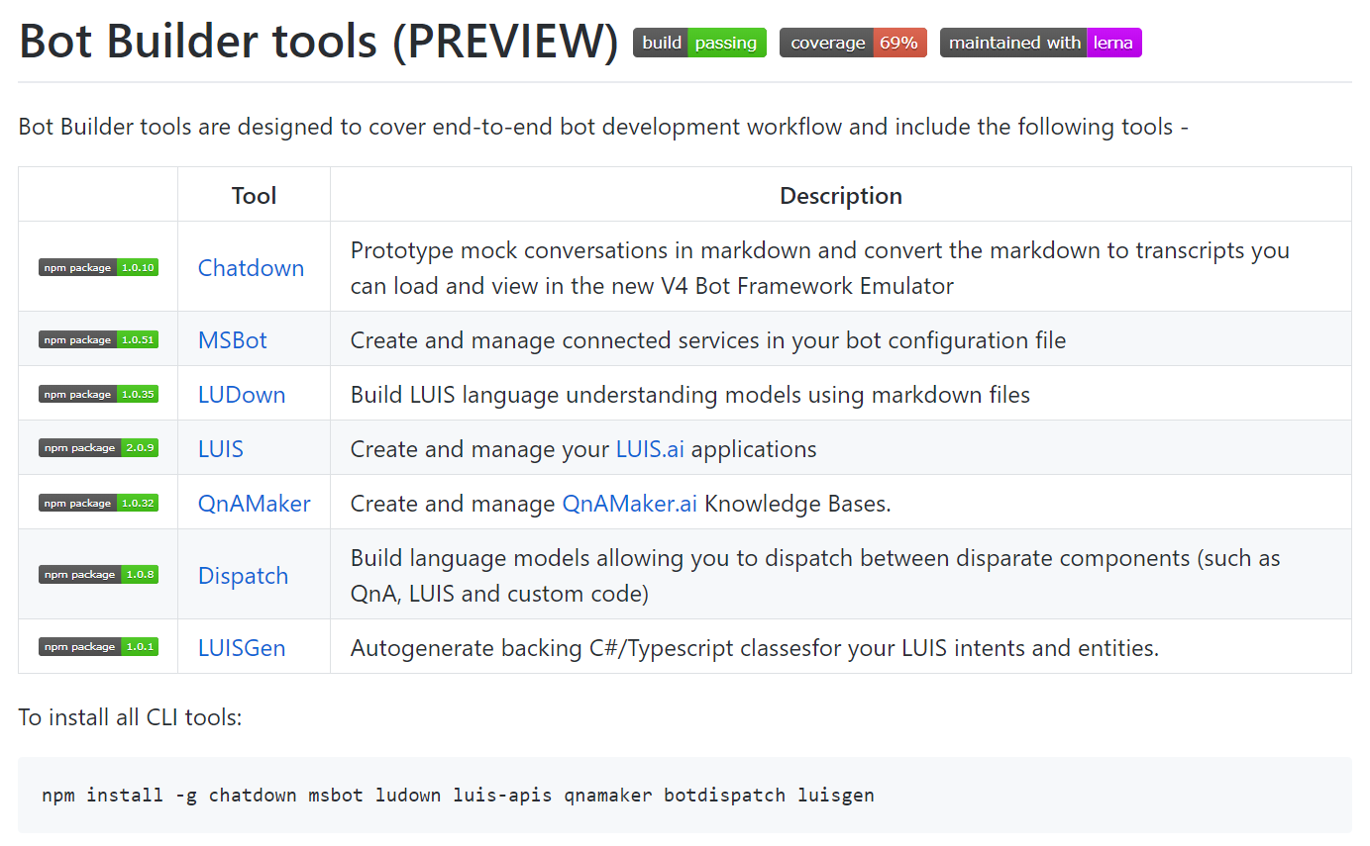
Comprehensive Bot Development Ex.
Awesome SDKs
Rich tool set
Great samples, templates, solutions and docs
https://github.com/Microsoft/botbuilder-tools
https://github.com/Microsoft/botbuilder-samples
https://github.com/Microsoft/AI/Solutions

